Slide 1

Program: ESE 4009
INSTRUCTOR: Prof. Mike Aleshams
Group 6
Rohan Yadav C0773871 Presented by: VANDANA EAGA
Shahrukh Padaniya C0769542
Swapnil Sevak C0777195
Vandana Ega C0777215

Slide 2

Project : Iot based cradle using SIDS monitor

Slide 3
VIDEO RECORDER INTERFACING WITH RASPBERRY PIE

Slide 4
CONTENTS
INTRODUCTION
BLOCK DIAGRAM
RASPBERRY PI SET UP
VNC VIEWER
USB CAMERA SPECIFICATIONS
IMAGE CAPTURE AND VIDEO CAPTURE BY GUVCVIEW
STREAMING LIVE VIDEO

Slide 5
INTRODUCTION:
IOT based cradle using SIDS monitor system works as a helping assistant of a mother who specializes in baby’s health monitoring.
This system provides alert in an emergency case, if the baby stops breathing or heart rate is not detected, so it will grab the attention of parents so that they can take action immediately. In addition to that, there will be video camera attached to it, so that parents can monitor remotely.
Cry detection circuits will analyse cry patterns and give information to parents if crying activity persists for a long time and activates swing of cradle . Wetness will be detected if baby urinate in the bed and provide alert to parents.
All sensors are always connected to the internet and GSM Module provide information through user friendly android apps. This app will have feature of swing control when baby is crying, switching to video surveillance.

Slide 6
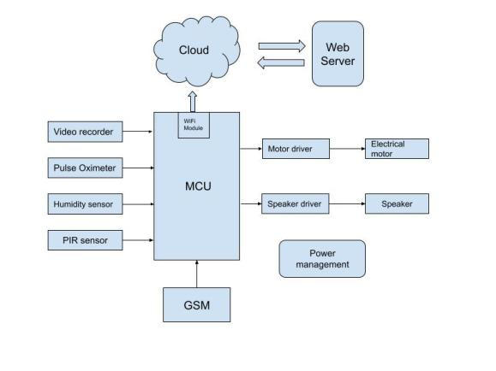
Block Diagram

Slide 7
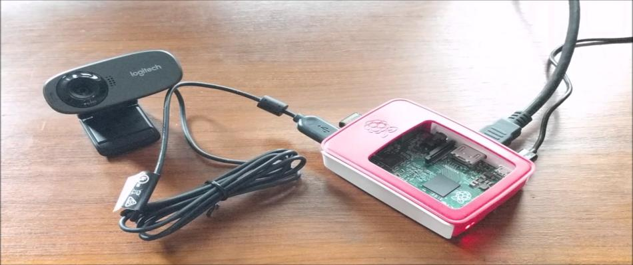
VIDEO RECORDER INTERFACING WITH RASPBERRY PIE

Slide 8
Microprocessor - RASPBERRY PI 3 MOD B+ BCM2837B0
Specifications:
SOC: Broadcom BCM2837B0, Cortex-A53 (ARMv8) 64-bit SoC
CPU: 1.4GHz 64-bit quad-core ARM Cortex-A53 CPU
RAM: 1GB LPDDR2 SDRAM
WIFI: Dual-band 802.11ac wireless LAN (2.4GHz and 5GHz ) and Bluetooth 4.2
Ethernet: Gigabit Ethernet over USB 2.0 (max 300 Mbps).
Power-over-Ethernet support (with separate PoE HAT).
Improved PXE network and USB mass-storage booting.
Thermal management: Yes
Video: Yes – VideoCore IV 3D. Full-size HDMI
Audio: Yes
USB 2.0: 4 ports
GPIO: 40-pin
Power: 5V/2.5A DC power input
Operating system support: Linux and Unix

Slide 9
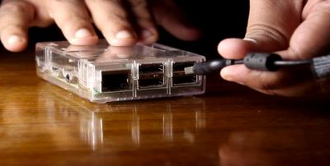
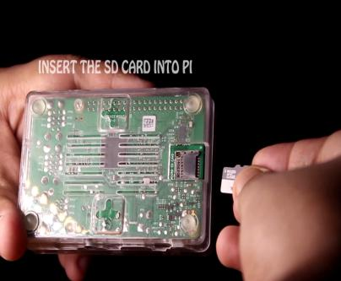
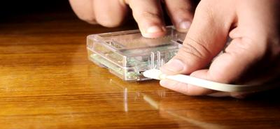
Raspberry Pi set up

Slide 10
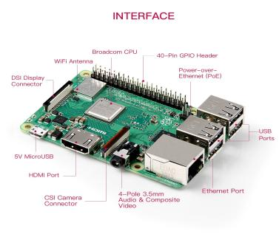
Finding Raspberry pi IP address
Open your browser on laptop or mobile.
Go to your Router settings by typing in the default IP address of your router.
Find the list of connected devices.
Find the corresponding IP address of the device named raspberry.
In this case the IP address is 192.168.137.213

Slide 11
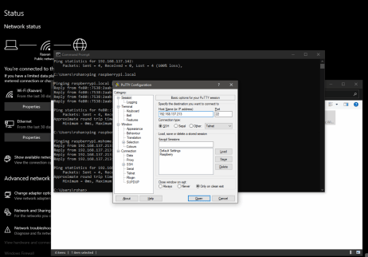
Connecting to raspberry pi to putty
Start putty and we will see the IP address and enter the address.
After that you will see the login prompt.
The default login for Raspberry Pi OS is pi with the password raspberry

Slide 12
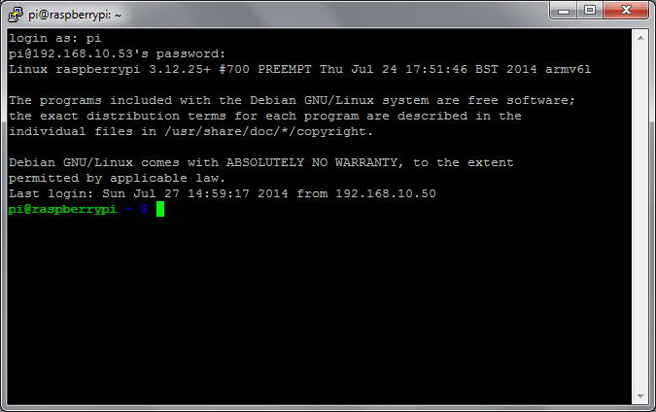
Connecting to raspberry pi to putty

Slide 13
VNC Viewer
Virtual Network Computing (VNC) is a graphical desktop-sharing system that employs the Remote Framebuffer protocol (RFB) to control another computer remotely in computing.
It transmits the keyboard and mouse input from one computer to another, relaying the graphical-screen updates, over a network.
VNC is platform-independent – there are clients and servers for many GUI-based operating systems

Slide 14
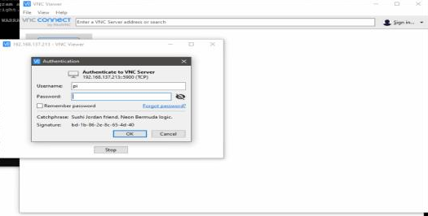
VNC Viewer
To login to the device we use default username and password as stated earlier.

Slide 15
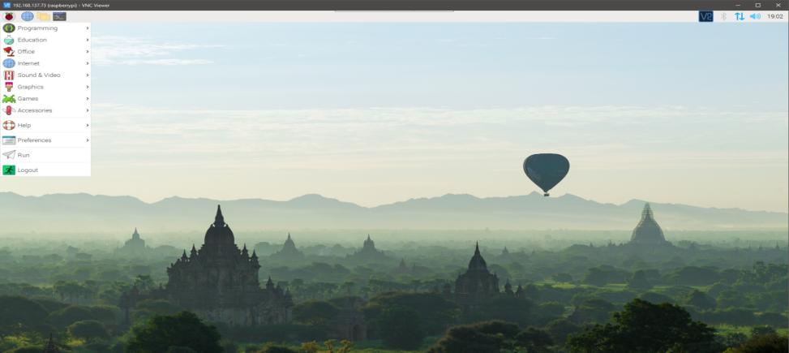
VNC Viewer

Slide 16
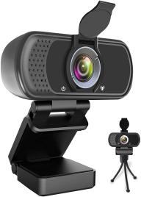
USB Camera
Full HD Webcam 1080P , Full HD Webcam 1080P provides more clarity video calling, streaming, conferencing, Max Resolution up to 1920 x 1080 pixels never miss any details.
110 Degree Wide-Angle Webcam with Stereo Microphone , Fixed focus desktop and laptop Webcam captures FULL HD video at a wide angle of up to 110 degrees. Great for webinars, video conferencing, live streaming, etc.

Slide 17
USB Camera
Benefit from H.264 compression, you can get faster, smoother HD video experiences.
Computer webcam auto adjusts color and brightness for natural lighting so you always look your best on web camera even in dim light.
PLUG AND PLAY Easy to use, easy to install. It works with both Windows and Mac operating system with plug and play so you do not have to set up any specific drivers or software, With a built-in mounting clip and a tripod thread, you can connect it to just about anything you can think of.

Slide 18
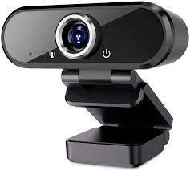
Specifications:
Image Stabilization-Digital
Video capture resolution-1080p
batteries required-No
Includes Rechargeable Battery-No
Includes External Memory-No
Parcel Dimensions-‎12.3 x 9.9 x 6.2 cm; 260 Grams

Slide 19
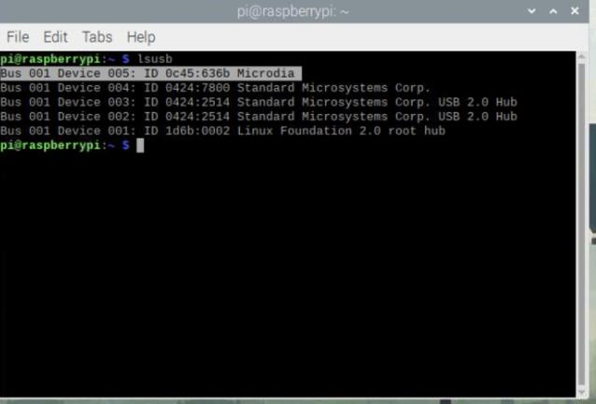
USB Webcam
When USB camera connected to RPi provides the USB devices list with the command.
lsusb
Here Microdia is the usb camera connected to raspberry pi.

Slide 20
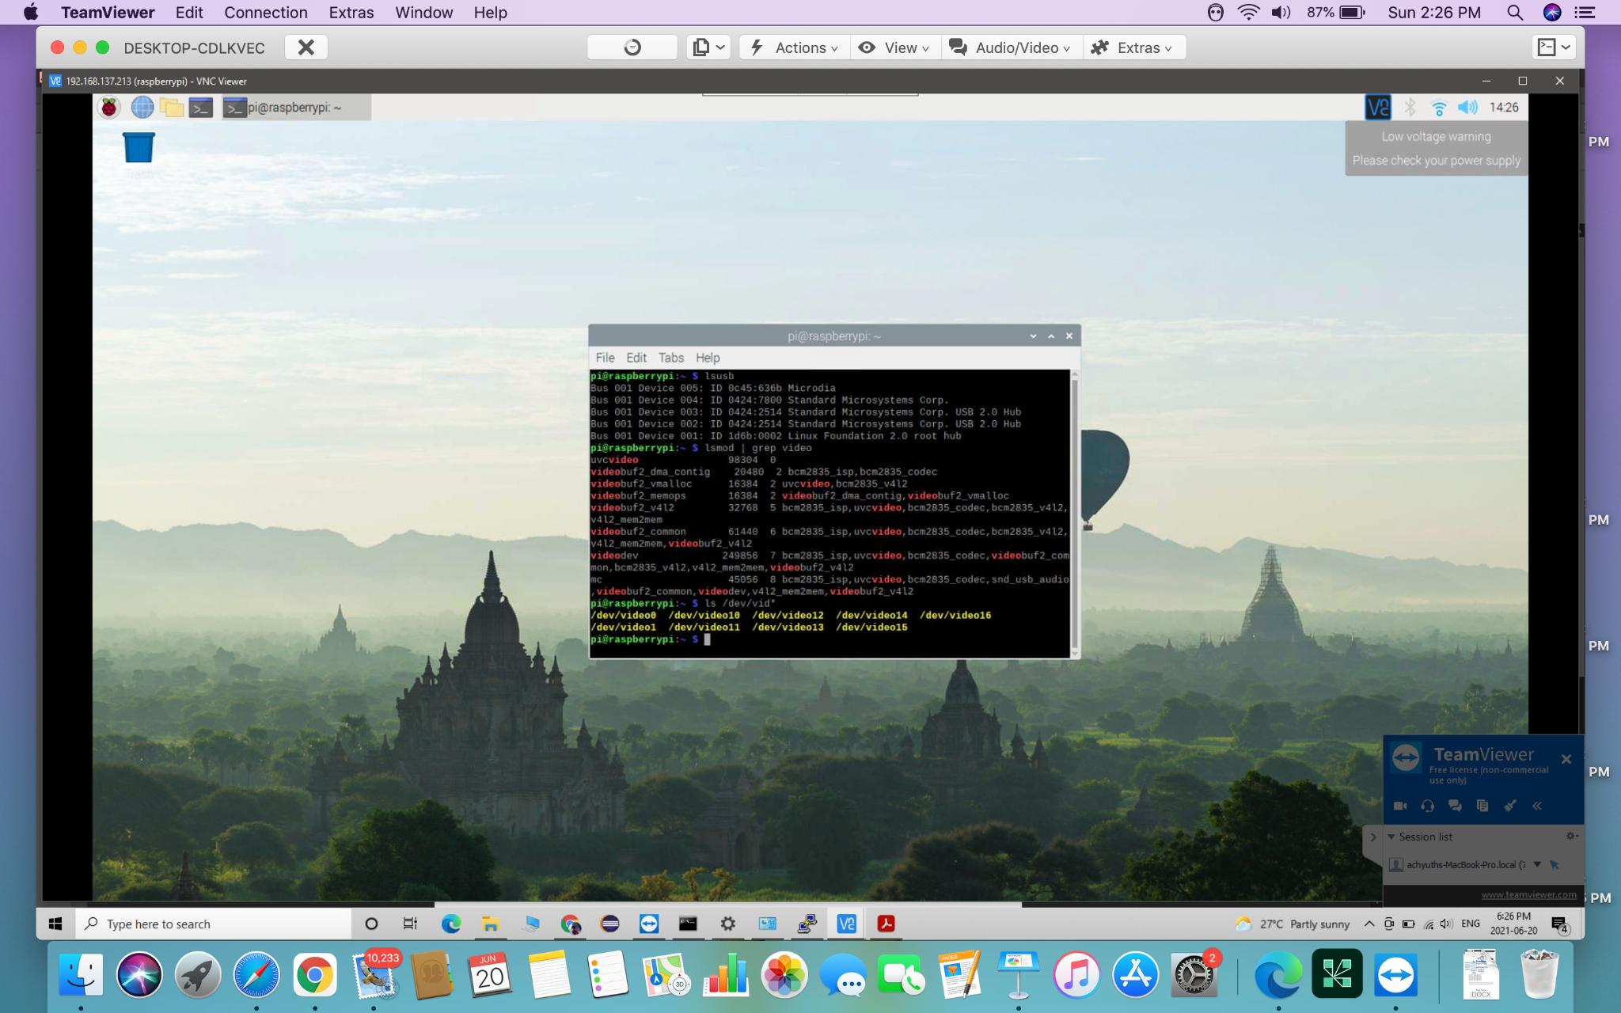
USB Webcam
lsmod | grep video is for the detailed and verbose output and lsmod is for the LKMs(memory allocator for Video4Linux video buffer) that are currently loaded can be listed
ls /dev/vid* lists new videos devices available.

Slide 21
Guvcview
Guvcview (GTK+ UVC Viewer) is a webcam application, i.e. software to handle UVC streams, for the Linux desktop.
It is compatible with all V4L2 camera devices, using the Linux UVC driver and based on luvcview for video rendering.
It uses a two-window interface in normal use. One window displays the camera image to be recorded and the other displays the settings and controls, as well as menus.

Slide 22
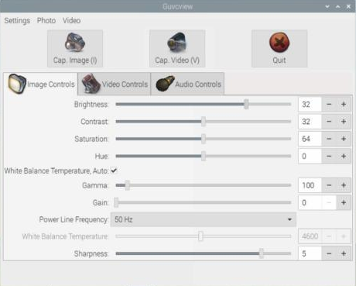
Installing Guvcview
Step 1:sudo apt-get update
Step 2:sudo apt-get install guvcview
Step 3:sudo apt-get install fswebcam
Step 4:guvcview

Slide 23
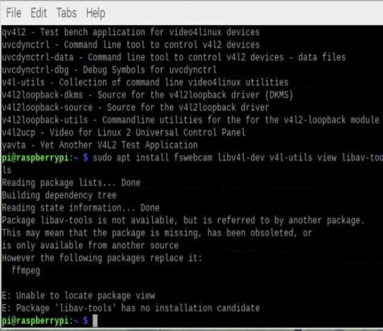
Image Capture
The fswebcam application can then be used to test that the attached web camera is working correctly. It is a surprisingly powerful and easy-to-use application
The image can then be viewed using guvcview, which requires that you have attached a display to the RPi, such as a VNC connection:

Slide 24
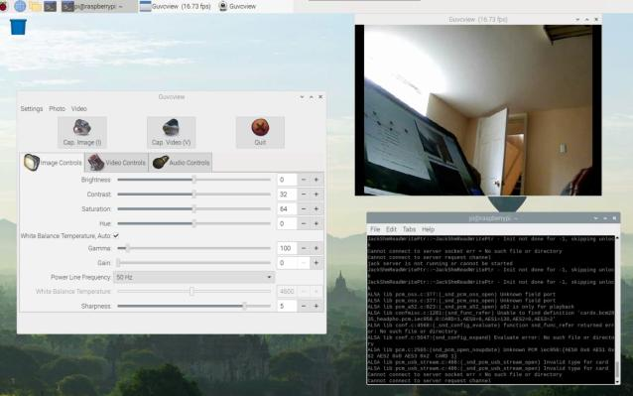
Image Capture
To capture an image we can also go with the command on the terminal
fswebcam image.jpg
Where it captures image and to display on PC with the command
eog image.jpg followed by
guvcview

Slide 25
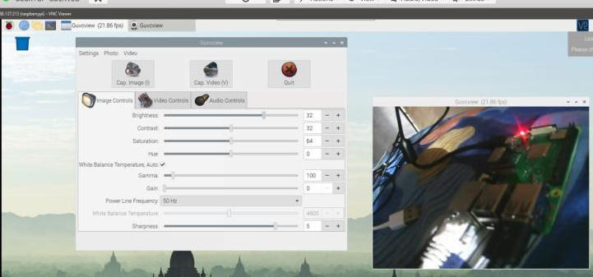
Video capture by Guvcview

Slide 26
Stream live Video
1.sudo apt-get update
2.sudo apt-get install motion
3.cd /etc/motion/
4.sudo nano motion.conf - scroll down and change ‘stream-localhost on’ to ‘stream-local host off’ and press ctrl-x and y and enter.
5.sudo motion -n
6.ifconfig - ethernet address 193.168.137.213 followed by :8081

Slide 27
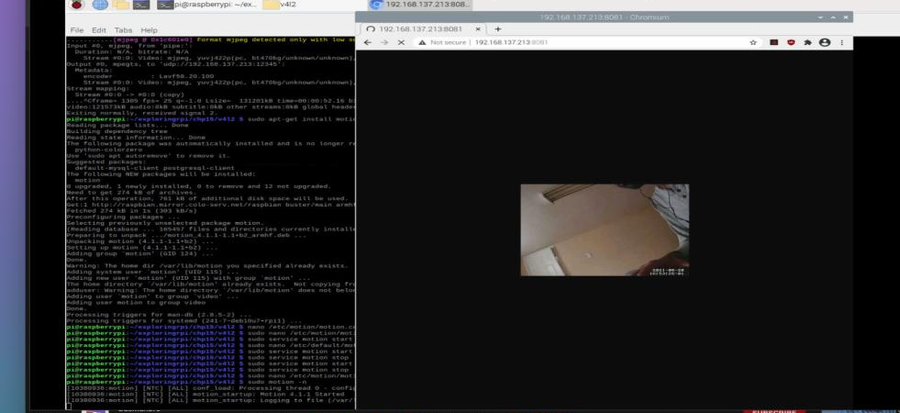
Stream live Video

Slide 28
REFERENCES
1.Vivek Gite, March 14, 2018,Raspberry PI 3 model B+ Released: Complete specs and pricing,https://www.cyberciti.biz/hardware/raspberry-pi-3-model-b-released-specs-pricing/
2.Batz, V. M. (2019, January 4). Introducing PiCockpit and PiDoctor – how to test your Raspberry Pi and get information about it. Pi3g.com. https://pi3g.com/2019/01/05/introducing-picockpit-and-pidoctor-how-to-test-your-raspberry-pi-and-get-information-about-it.
3.amazon. (n.d.). https://www.amazon.ca/dp/B07Z2GZTYY/ref=redir_mobile_desktop?_encoding=UTF8&psc=1&ref=ppx_pop_mob_b_asin_title

Slide 29
REFERENCES
4.How to Make Raspberry Pi Webcam Server and Stream Live Video || Motion + Webcam + Raspberry Pi. (n.d.). instructables circuits. https://www.instructables.com/How-to-Make-Raspberry-Pi-Webcam-Server-and-Stream-/
5.install GTK+ UVC Viewer (UNOFFICIAL) on Raspberry Pi. (n.d.). snapcraft. https://snapcraft.io/install/guvcview/raspbian
6.Virtual Network Computing. (n.d.). wikipedia. https://en.wikipedia.org/wiki/Virtual_Network_Computing
7.DEREK MOLLY. (2016). Exploring Raspberry pi. WILEY. https://www.amazon.ca/Exploring-Raspberry-Pi-Interfacing-Embedded/dp/1119188687

Slide 30


